Slide 1

AH-64 Boeing Heat Exchanger Demonstrator
Northern Arizona University
2023-2024

Slide 2
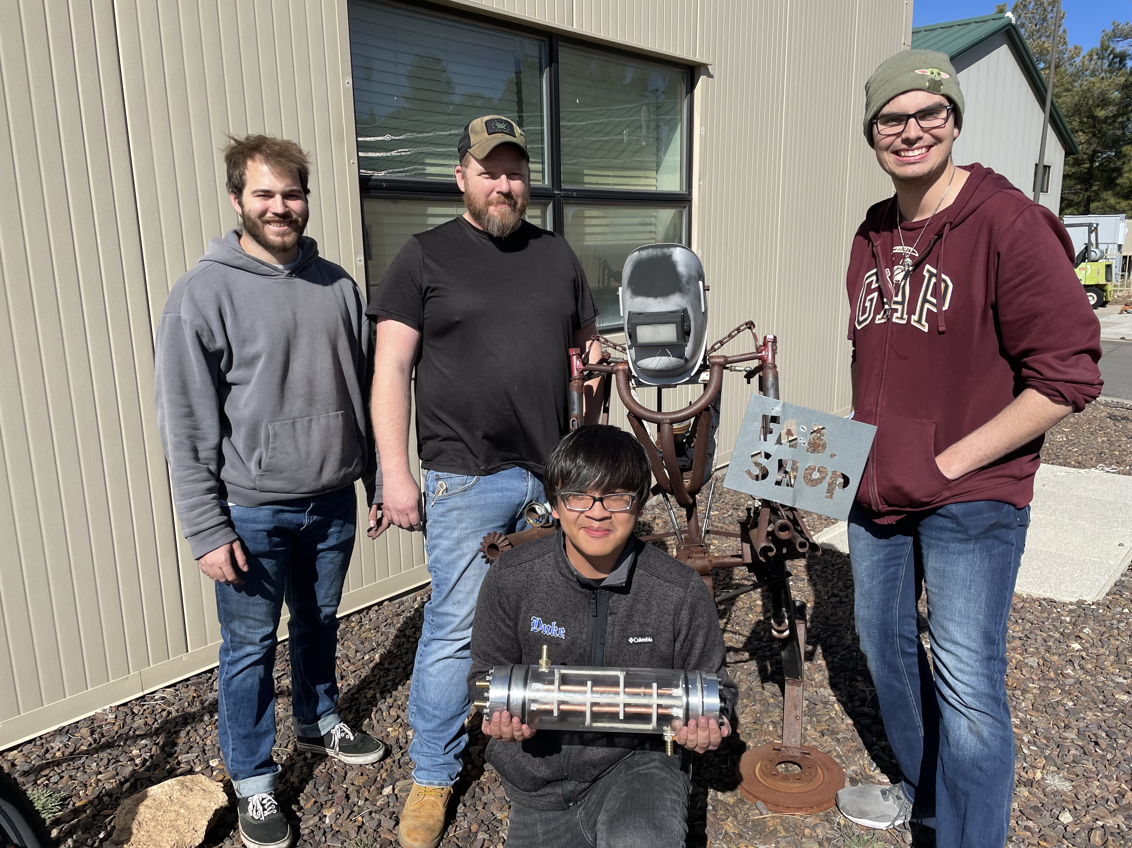
Introductions
The Team
Team Lead: Uriah Whitaker
Manufacturing Engineer: Dennis Decker
Cad Engineer: Lorenz Vios
Test Engineer: Christopher Mason
Faculty
David Willy, Technical advisor
Perry Wood
Jesus Mora
Figure 1. The Team

Slide 3
Project Summary
Design and creation of a liquid-to-liquid heat exchanger as a demonstrator for the real-world application of isolating a flammable environmentally friendly refrigerant
One loop will be Ice water to represent HFO-1234Y and the coolant loop will be a standard 50-50 Water-Propylene Glycol mix
Strong emphasis on maximizing heat transfer effectiveness
System will be a portable demonstration unit
Selected a shell and tube heat exchanger design primarily for manufacturability
2-tube dual pass system for purpose of maintaining turbulent flow while remaining under size constraints

Slide 4
Requirements
Main requirements
  System must be portable
  Heat exchanger must remain under 6x6x18 inch dimensions
  System must have a clear housing
  Must channel cool air to the judges' hands
System Verification
  Utilizes the ε-NTU method to predict the effectiveness of the system
  Plans to pressure test the system to confirm seals will hold above operational pressure
  Utilizes 8 K-type thermocouples to measure temperatures at key points
  Uses flow sensors to accurately measure flow since ε is related to the flow rates
  Pressure gauges to ensure system is operating as intended
  Post-testing, the system will be mounted to a cart and a person will be able to feel cold air from the fans for at least 30 minutes

Slide 5
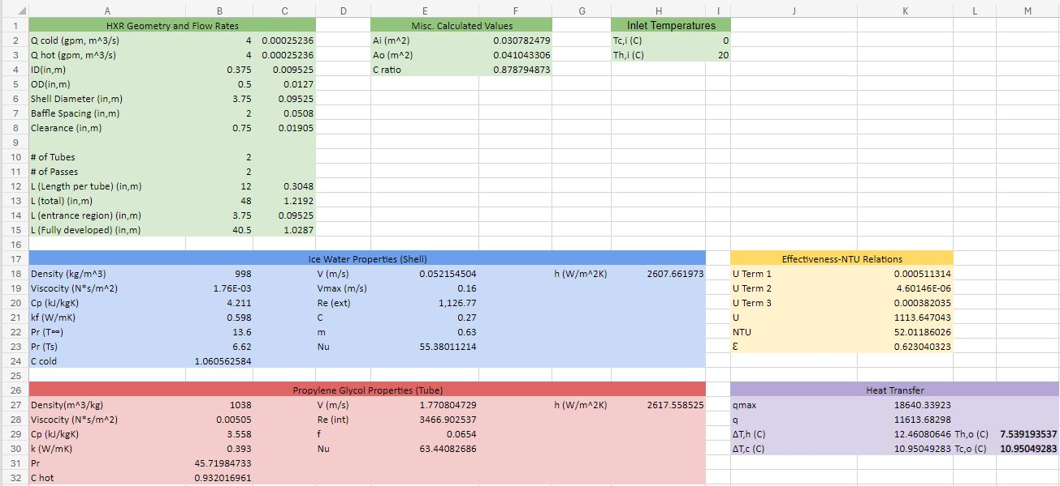
Analysis
Figure 2. Mathematical model

Slide 6
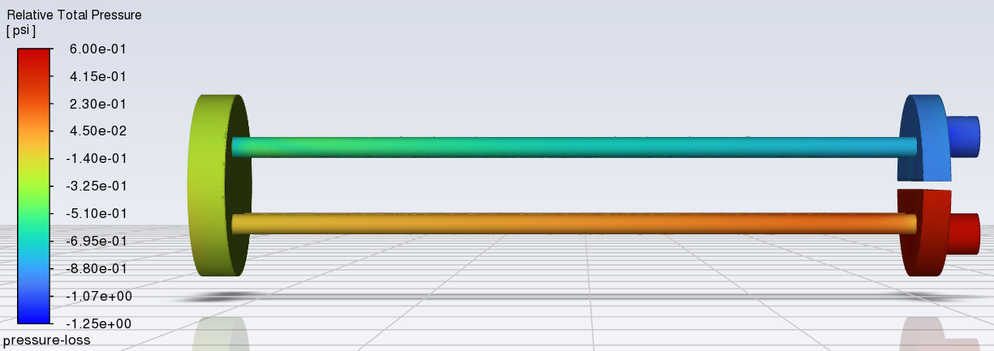
Analysis
Figure 3. ANSYS Fluent Pressure Loss Simulations

Slide 7
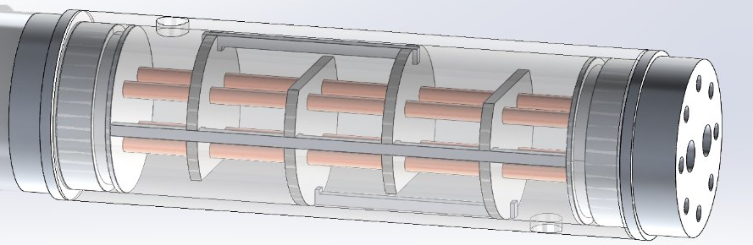
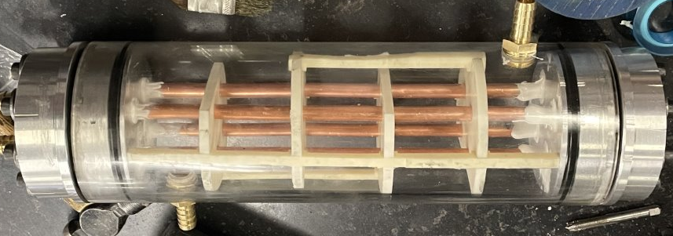
Final Prototype
Figure 4. Final Cad model
Figure 5. Final Prototype

Slide 8
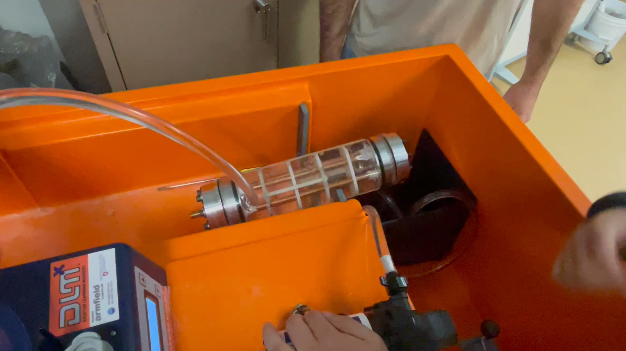
Preliminary Testing
Flow Testing
Video 1. Initial Flow Testing

Slide 9
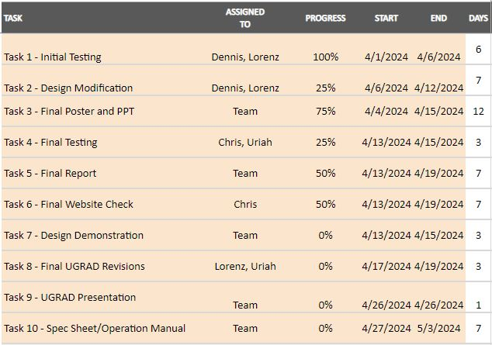
Schedule
Current Status
Prototype built and currently testing
Figure 6. Gantt Chart/Project Timeline

Slide 10
Q&A

